Slide 1


GCA5 SPONSORSHIP
DECK
Notes:
Title Screen

Slide 2
Table of Contents
GCA Sponsorship Deck
GCA Overview…………………………………………….. 3
GCA Media Impact…………………………………….. 4
GCA Participant Demographics ………………5
GCA5 Forecast..……………………………………………6
GCA5 Value..………………………………………………….7
Platinum Level Sponsorship……………………..8
Gold Level Sponsorship……………………………..9
Participant Experience…………………………….10
Conclusion…………………………………………………….11

Slide 3
Great Canadian Appathon
The Only National Game Development Hackathon
The Great Canadian Appathon (GCA) is a national video game hackathon for Canadian college and university students. Aspiring game developers have 48 hours to design the next hit video game for mobile and desktop platforms.
The GCA was created in 2011 as a way of engaging with and giving back to the student game developer community. Since it’s inception, the GCA quickly grew to become a favourite hackathon on students’ calendars, where the best computer engineers and game developers test their skills in the field, and at many schools an accredited extracurricular activity.
GCA
GCA⁴
Mar 2011
GCA²
GCA³
Jan 2014
4 Provinces
7 Schools
94 Teams
296 Students
54 Games
All Provinces
40+ Schools
150+ Teams
500+ Students
100+ Games
Oct 2011
Sept 2012
Oct 2011

Slide 4
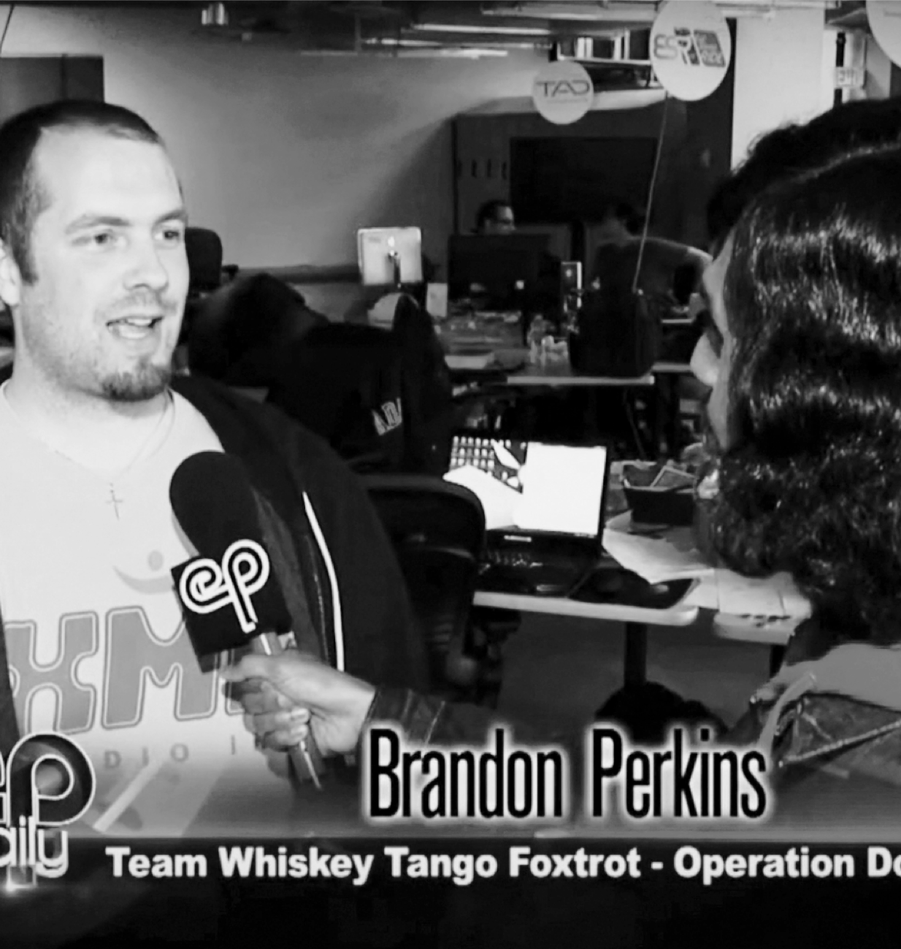











Media
The GCA⁴ had a combined media reach of nearly 8 million and 600,000+ student reach.
GCA³ Hackathon Participant
January 2014, GCA³ Ryerson DMZ HUB, Toronto
Notes:
Photo Layout 2

Slide 5
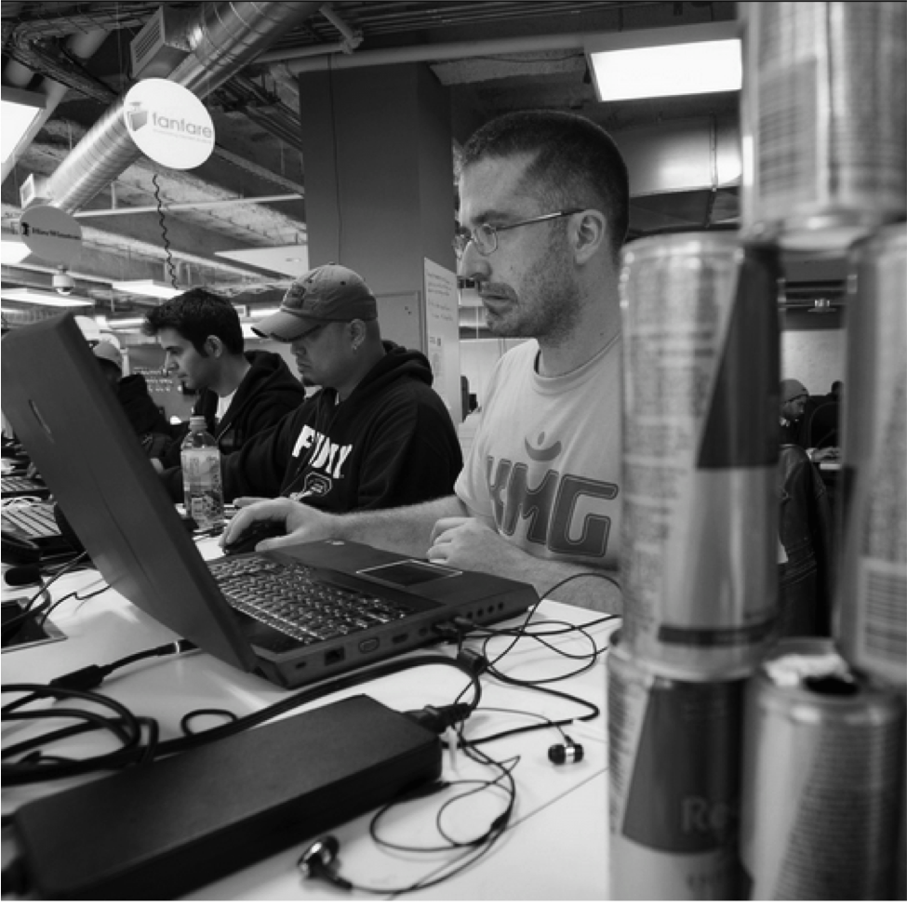
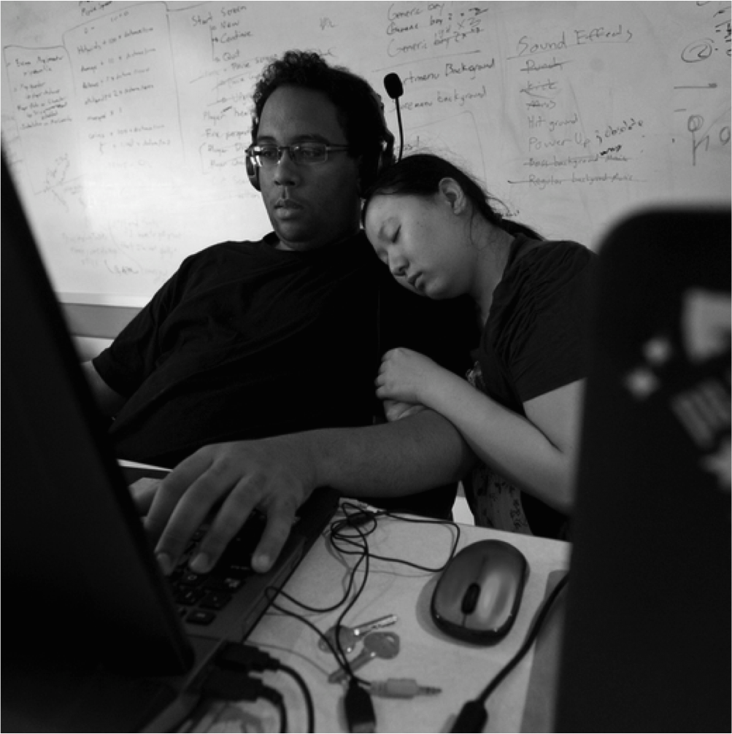
GCA PARTICIPANTS
Who are they?
WHO
Age 17-27 University and College students with a high level of technical skills, seeking experience to pursue a career as a software developer and/or digital designer.
LOCATION
Major Universities and college campuses across Canada
INTERESTS
Games, programming, technology, mobile apps
Team Friend Boat, $25,000 Grand Prize winner from the Ontario Institute of Technology.
After refueling with red bull, GCA³ participants are back to hack at the Ryerson DMZ GCA HUB.
Power naps are the way to go at Hackathons. This adorable pair of GCA³ participants is catching some zzzzz’s.
Notes:
One Column Layout

Slide 6







GCA 5
Event Forecast
WHEN
Winter 2015/2016
GAMES SUBMITTED
130+ games
BUZZ
Media coverage in every province across Canada
PARTICIPANTS
500+ game makers
LOCATION
25+ Colleges and Universities
TEAMS
135+ teams
Notes:
One Column Layout

Slide 7
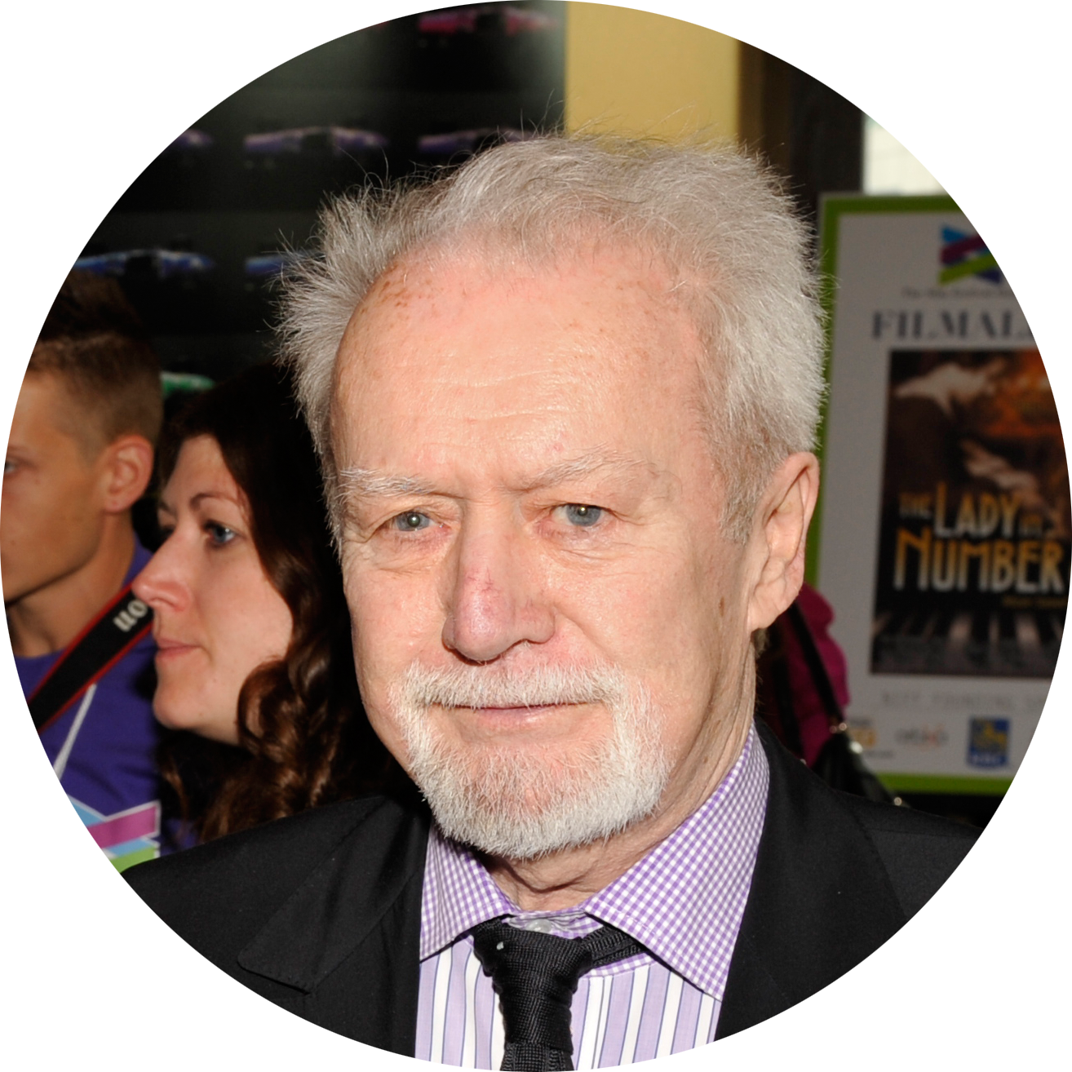

“We expect nothing less than the students to emerge from GCA3 with learning more about commercial software development than any other experience in their student careers,”
Bill Marshall
Founder of the Toronto International Film Festival, and a member of the GCA3 judging panel
”It’s great to see the young Canadian talent we have… the innovation, thinking outside the box… for me, this is a real passion."
Tony Clement
The Hon. Tony Clement, President of Treasury Board of Canada and a member of the GCA4 judging panel
Notes:
Quote Layout 1

Slide 8




GCA VALUE
What value does the GCA offer sponsors?
BRANDING
Branding all over a national hackathon and the option to base the GCA theme around your brand
RECRUITMENT
Recruit from a group of future graduates looking for jobs and utilize the unique ability to look at a candidate's’ product development capabilities, team dynamics and stress resistance
INNOVATION
Be at the front of a hackathon, a hotbed for innovation where those with the passion to create, build something new out of nothing
CONNECT & ENGAGE
Connect with and tap into a tech-savvy student community of creative enthusiasts that will engage with your brand, services and products
Notes:
One Column Layout

Slide 9
SPONSORSHIP OPTIONS
PLATINUM SPONSOR
GOLD SPONSOR
$20K
$10K
Branding/naming rights over GCA5 (ex. Your Co presents: the Great Canadian Appathon 5)
Exclusive recruiting access from 500+ developers
Advisory role in creative execution of GCA5 (think “light touch, high impact”)
Speaking slot of your choosing at the hackathon event
Right to pick the GCA theme, allowing you to base all the games created at the GCA around your brand
Includes ALL GOLD level sponsorship perks
Recruiting access to all GCA participants
Shout-out at opening and closing ceremonies
30 minute breakout talk during hackathon event
Receive 1 spot on the GCA judging panel
A custom news release will be written about the Gold Sponsors.
Gold Sponsor products/services will be integrated into the GCA
Gold Sponsor’s logo will be on all GCA media releases, signs, banners and printed materials and GCA swag (t-shirts, bags, hats etc.)
Gold Sponsor brand integration into GCA social media plan

Slide 10
SPONSORSHIP OPTIONS
SILVER SPONSOR
GOLD SPONSOR
$5K
In Kind
One of the category prizes named after each Silver Sponsor
Silver Sponsor included in GCA media releases, GCA signs and banners, printed materials and GCA swag
Silver sponsorship details and links to sponsors website will be on the GCA website,
Opportunity to provide marketing materials and giveaways in participants swag bags
Silver sponsors can promote their products, and services at the HUBs and engage with participants
Sponsor recognition on GCA HUB signage and all GCA advertising and promotional material
Sponsor recognition on the GCA webpage and link to sponsors website
Opportunity to provide marketing materials and giveaways in participants swag bags

Slide 11
Participant Experience
“The appathon, in my opinion, was the best way to really put all the information we studied and practiced during class hours into something physical and concrete, something that could be measured and judged in the real world and see what we could accomplish as a team.”
GCA Participant
“You can take courses and develop your programming knowledge, but in a competition you have to think on your feet and troubleshoot quickly – those are very valuable skills”
Professor of Physics & Computer Science at Laurier University
Notes:
Quote Layout 2

Slide 12
THANK YOU FOR YOUR TIME
We’re excited to work with you!
Patti Mikula, Co-Founder & CEO
patti@hackworks.com
Notes:
Thank you slide

